Slide 1
Context Based Sentiment Analysis
Team 1B
Attaluri Lalith Chandra
Karumanchi Pranitha Saroj

Slide 2
Abstract
The main idea of our project is to use Spark Streaming to do the ETL process and to implement the machine learning concepts on that data in real time.Our device source is titter data ande’d be using Streaming Content, Which is real-time data processing and using streaming API we’d do the transformations on the RDD’S streaming set and load the data into the hive framework which is similar to the basic ETL method. We will also be executing the EDA on twitter data while capturing the databackground. Our project would also highlight the sentiment analysis system where the tweets are populated with real-time sentiments. It also describes the keyword reasons for categorizing a tweet into positive or negative sentiment.

Slide 3
Architecture Flow
Data collection (Twitter API)
Streaming
Client/server model
Train-Test (Model)
Sentiment Comparision
Hive
Comparing UDF & PDF

Slide 4
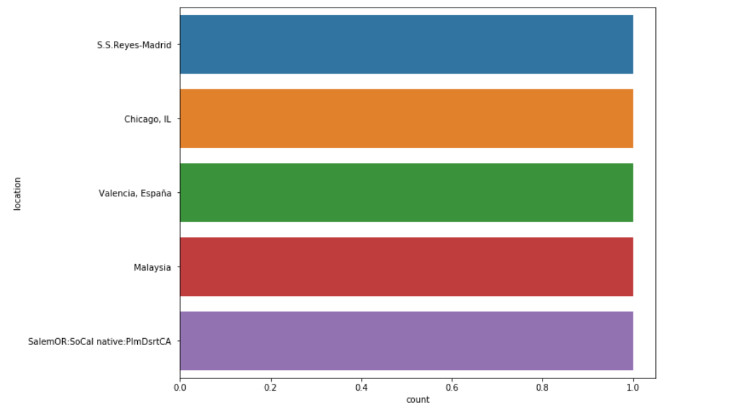
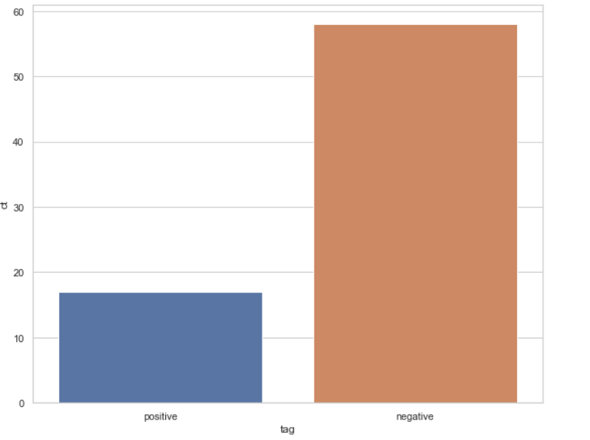
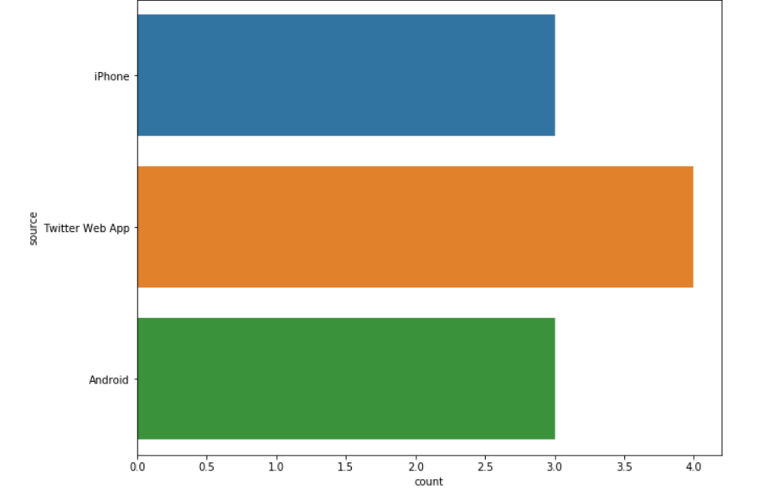
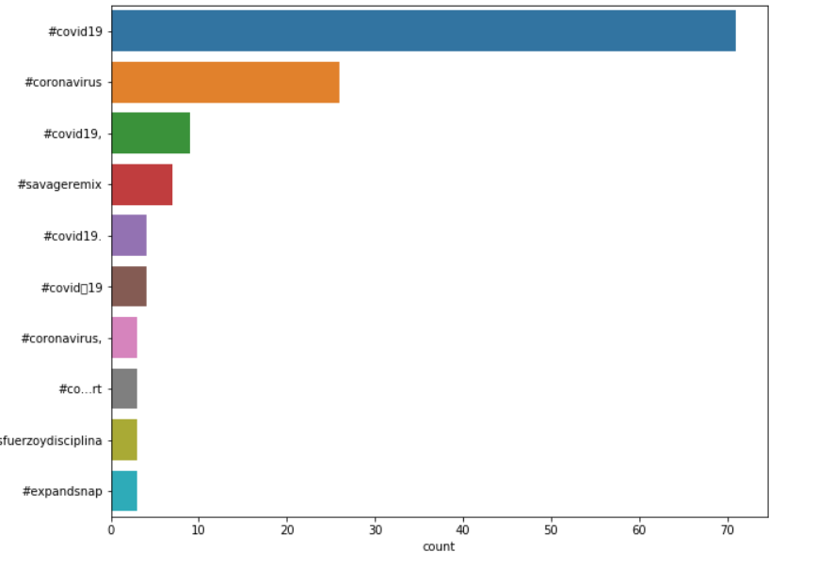
Data Visualization

Slide 5
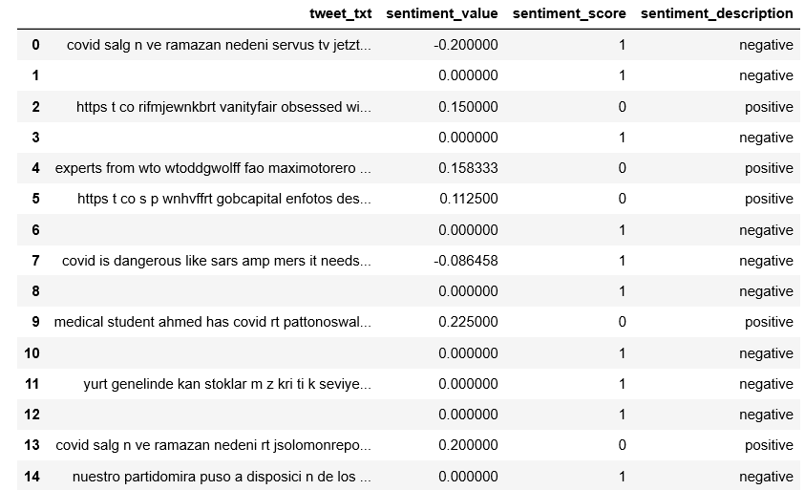
Data Preprocessing

Slide 6
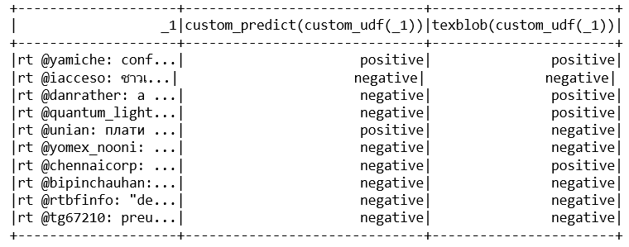
Sentiment Analysis of Real-Time Data

Slide 7
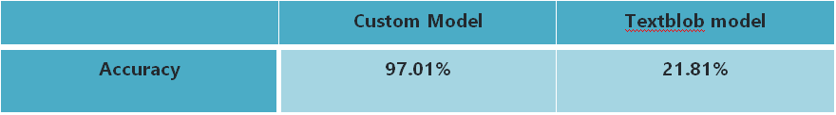
Models-Comparision

Slide 8
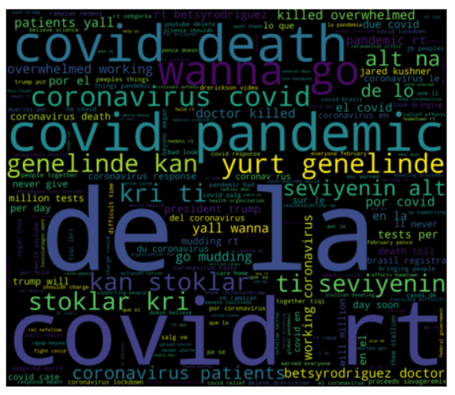
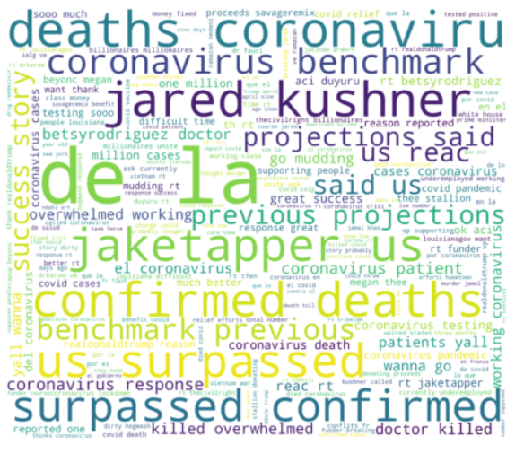
Features of Sentimental Analysis

Slide 9
Conclusion
From our analysis, we conclude that the context-based model has good accuracy than the pre-trained models.
Important features are covid, pandemic, death
Least important features are aa, aarod, aahmad, aalac, accept

